Slide 1
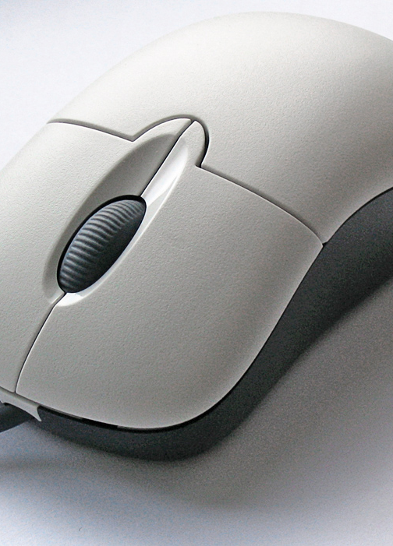
THE MOUSE

Slide 2
What is mouse
A computer mouse is a hand-held pointing device that detects two-dimensional motion relative to a surface. This motion is typically translated into the motion of a pointer on a display, which allows a smooth control of the graphical user interface of a computer.

Slide 3
Types of mouse
1) Bluetooth mouse
2) Trackball mouse
3) Optical mouse
4) Track pads
5) Track point

Slide 4
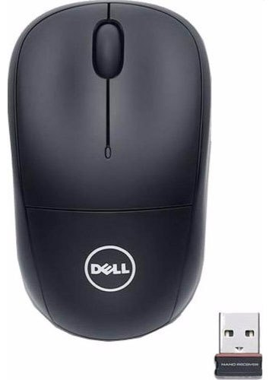
1)Bluetooth mouse
Bluetooth is a short-range wireless communication technology standard. A mouse that connects to the computer without a card. Bluetooth mice are commonly used with tablets, because most tablets have Bluetooth built in. They can also be used with a computer that has Bluetooth from the factory or via an adapter.

Slide 5
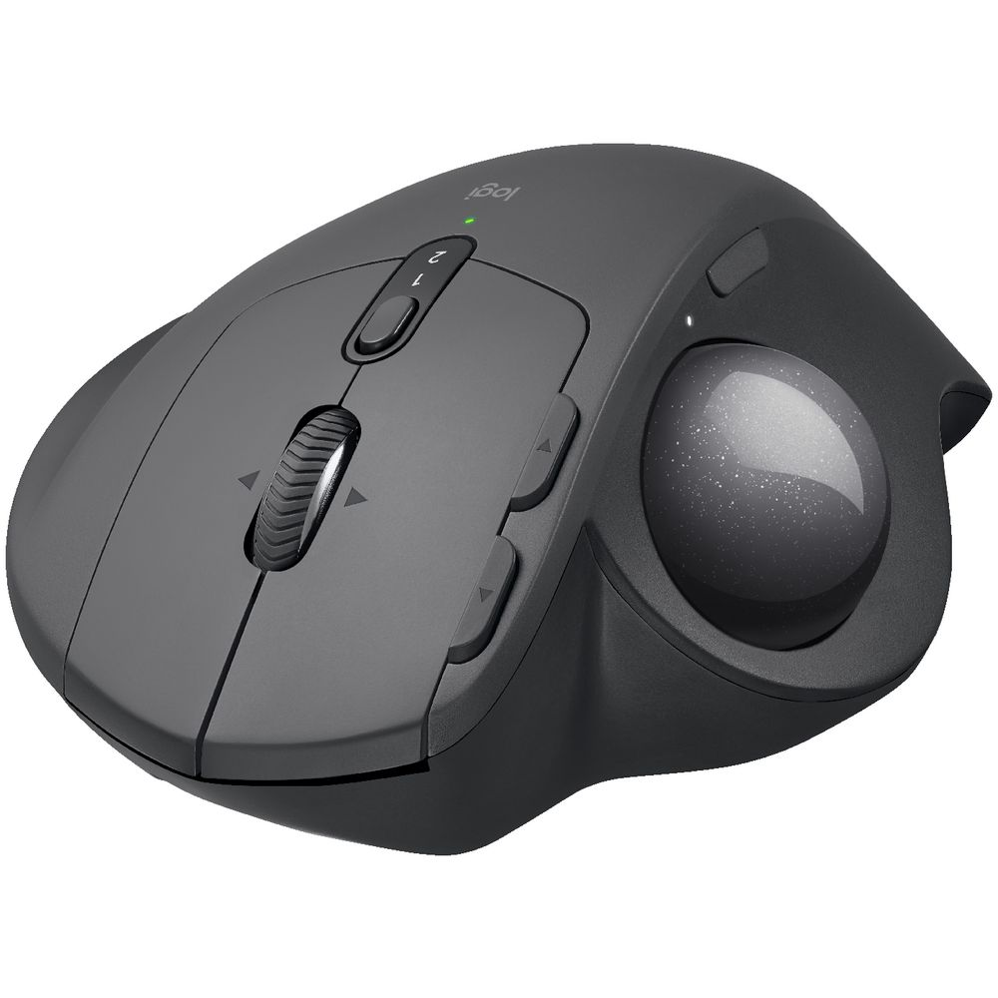
2) trackballs
A trackball is a pointing device consisting of a ball held by a socket containing sensors to detect a rotation of the ball about two axes –like an upside down mouse with an exposed protruding ball.
Upside down mouse
Hand rests on the ball
User moves the ball
Uses little desk space

Slide 6
3)Optical mouse
A optical mouse is a computer mouse which uses a light source, typically a light-emitting diode (LED), and a light detector, such as an array of photodiodes, to detect movement relative to a surface…. The earliest optical mice detected movement on printed mousepad surfaces.
Light shown onto mouse pad
Reflection determines speed and direction
Requires little maintenance

Slide 7
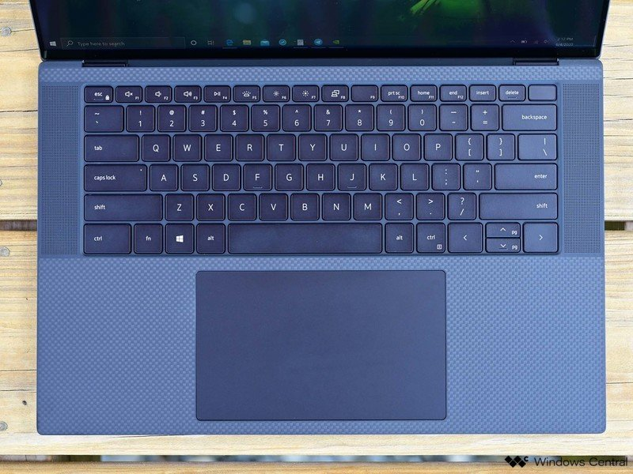
4)Track pads
A touchpad or trackpad is a pointing device featuring a tactile sensor, a specialized surface that can translate the motion and position of user’s fingers to a relative position on the operating system that is made output to the screen.
Stationary pointing device
Small plastic rectangle
Finger moves across the pad
Pointer moves with the pointer
Popular on laptops.

Slide 8

5) Track point
A pointing stick is a small joystick used as a pointing device typically mounted centrally in a computer keyboard. Like other pointing devices such as mice, touchpads or trackballs, operating system software translates manipulation of the device into movements of the pointer or cursor on the moniter.
Little joystick on the keyboard
Move pointer by moving the joystick.

Slide 9
Interacting with a mouse
Action involve pointing to an object
Clicking selects the object
Clicking and holding drags the object
Releasing an object is a drop
Right clicking activates the shortcut menu
modern mice include a scroll wheel

Slide 10
Benifits
pointer positioning is fast
Menu interaction is easy
Users can draw electronically.

